Slide 1
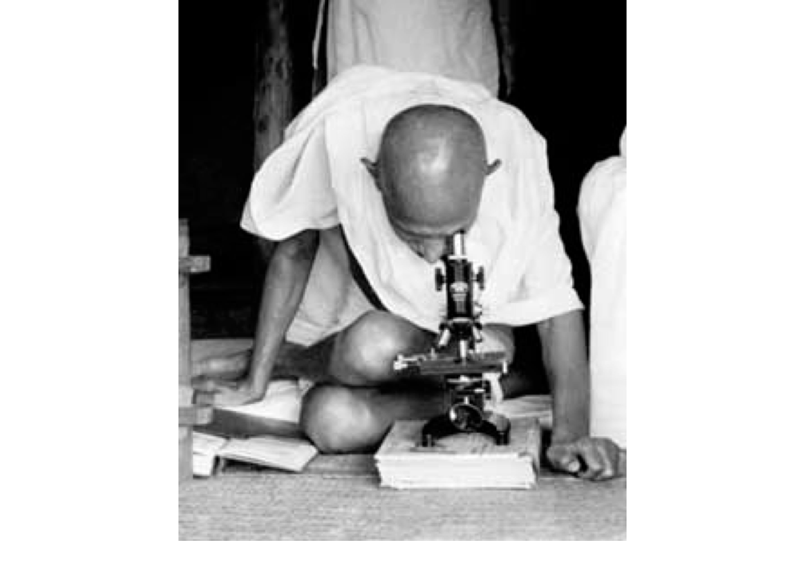
SCIENCE, TECHNOLOGY, SOCIETY(HM 216)

Slide 2
COURSE OBJECTIVES
WILL BEGIN BY ASKING QUESTIONS SUCH AS
“WHAT IS SCIENCE? WHAT IS TECHNOLOGY?
HOW ARE THEY RELATED?
WHERE DOES SOCIETY COME INTO A DISCUSSION OF SCIENCE AND TECHNOLOGY?
WHY SHOULD WE CARE?

Slide 3
INTERDISCIPLINARITY
TO ANSWER THOSE QUESTIONS WE WILL HAVE TO TAKE THE HELP OF A RANGE OF HUMANITIES AND SOCIAL SCIENCE DISCIPLINES LIKE:
PHILOSOPHY, HISTORY, SOCIOLOGY, ANTHROPOLOGY
WHAT KIND OF QUESTIONS DO THESE DISCIPLINES ASK? WHAT ARE THERE CONCERNS?

Slide 4
CRITICAL THINKING
AT THE HEART OF ALL THESE DISCIPLINES IS THE EXERCISE OF CRITICAL THINKING.
WHAT IS CRITICAL THINKING? AND WHY IS IT SO IMPORTANT IN OUR TIMES?
AT ITS BASIC DEFINITION CRITICAL THINKING IS THE OBJECTIVE ANALYSIS OF AN ISSUE IN ORDER TO FORM A JUDGEMENT.

Slide 5
THE ORGINS OF CRITICAL THINKING
THE GREEK PHILOSOPHER SOCRATES, 470-399 BC
SOCRATES SET THE AGENDA FOR CRITICAL THINKING BY URGING HIS DISCIPLES TO QUESTION COMMON BELIEFS, TO UNDERSTAND THE VESTED INTEREST OPERATING BEHIND BELIEFS THAT ARE UNREASONABLE OR ILLOGICAL. ENCOURAGED, REFLECTION, AND THE EXERCISE OF LOGIC AND REASON OF OBSERVATION AND EVIDENCE.

Slide 6
HOW IS THIS RELEVANT TO HM 216?
THIS IS A COURSE THAT WILL ENCOURAGE TO CONFRONT UNORTHODOX VIEWS OF SCIENCE AND TECHNOLOGY.
THIS IS NOT TO SAY THAT THIS COURSE IS ANTI-SCIENCE OR ANTI-TECHNOLOGY
IT MERELY PUSHES YOU TO ASK WHAT SCIENCE, WHAT TECHNOLOGY DO WE NEED AND WHY? WHO DECIDES?

Slide 7
ARE SCIENCE AND TECHNOLOGY AUTONOMOUS?
DO YOU BELIEVE THAT SCIENCE AND TECHNOLOGY ARE COMPLETELY AUTONOMOUS DOMAINS OF HUMAN ENDEAVOUR? OR DO YOU THINK EVERY SCIENTIFIC QUESTION WE ASK, EVERY TECHNOLOGY WE INTRODUCE INTO HUMAN LIVES IS BEING PUSHED BY SOME FORCE WE DO NOT KNOW OR DO NOT CARE ABOUT?

Slide 8
THE ORIGINS OF STS
THE BEGINNINGS GO BACK TO THE HISTORICAL PERIOD SOON AFTER THE FIRST WORLD WAR (JULY 1914-NOV 1918)
FOUGHT BETWEEN ALLIED POWERS REPRESENTED BY BRITAIN,FRANCE,RUSSIA, UNITED STATES - AND THE CENTRAL POWERS LED BY GERMANY, AUSTRIA-HUNGARY,THE TURKISH OTTOMAN EMPIRE

Slide 9
CONSEQUENCES OF THE GREAT WAR
9 MILLION COMBATANTS, 7 MILLION CIVILIANS DEAD- SEVERAL WOUNDED AND MAIMED FOR LIFE- ENORMOUS DESTRUCTION OF PROPERTY
ALL THE RESULT OF ? THE USE OF MASSIVE AND NEW TECHNOLOGIES OF WAR- NEW FORMS OF CHEMICAL WARFARE . IN OTHER WORDS THE WAR SAW THE MASSIVE DEPLOYMENT OF S AND T

Slide 10
RE-THINKING THE IMAGE OF SCIENCE
FROM THE BEGINNINGS OF MODERN SCIENCE IN THE 17TH CENTURY UP TO THE EARLY 20TH CENTURY- SCIENCE ENJOYED A POSITIVE IMAGE.
WAS LOOKED UPON AS A FORCE OF PROGRESS AND PROSPERTIY- OF THE HIGHEST FORM OF HUMAN CREATIVITY, OF THE SINGLE GREATEST SOURCE OF SUSTAINED SURVIVAL OF HUMANKIND

Slide 11
NEW ASSESSMENTS OF SCIENCE AND TECHNOLOGY
SCIENCE AND TECHNOLOGY WERE NOT UNQUALIFIED PROGRESSIVE FORCES- THEY COULD ENSURE THE PROGRESS AND PROSPERITY OF HUMAN KIND- BUT ALSO DESTROY IT.
CRITIQUES OF MODERN SCIENCE DURING THIS PERIOD BEGAN WITH CRITIQUES OF WARFARE AND ITS DESTRUCTIVE CONSEQUENCES- WHILE STATES DEPLOYED MORE AND MORE SC AND TECHNOLOGY IN WARFARE, SOME SCIENTISTS BEGAN TO QUESTION IT.

Slide 12
2 QUESTIONS
SCIENCE FOR HUMAN WELFARE OR SCIENCE FOR WARFARE?
MARXIST WRITERS LIKE THE SCIENTIST J.D. BERNAL MADE THE DISTINCTION BETWEEN BOURGEOIS OR CAPITALIST SCIENCE AND SOCIALIST SCIENCE
CAPITALIST SCIENCE- SCIENTIFIC KNOWLEDGE THAT WAS TIED TO THE IDEOLOGY OF A CAPITALIST SOCIETY- PROFIT SEEKING

Slide 13
BERNAL- SOCIAL FUNCTION OF SCIENCE 1939
SOCIALIST SCIENCE – SCIENCE AND TECHNOLOGY TIED TO THE IDEOLOGY OF PUBLIC GOOD AND WELFARE.
ARGUMENT- THE IMPACTS OF SCIENCE AND TECHNOLOGY DEPENDED ON THE SOCIETIES AND THE IDEOLOGIES TO WHICH THEY WERE TIED.

Slide 14
PHILOSOPHERS OF SCIENCE
PHILOSOPHERS OF SCIENCE ARGUED THERE WAS NEED TO –RE-EXAMINE ITS METHODS OF ESTABLISHING KNOWLEDGE OR TRUTH.
HOW IS SCIENTIFIC TRUTH ESTABLISHED – WHAT ARE ITS METHODS? ARE THESE METHODS UNIVERSALLY VALID?

Slide 15
POSITIVISTS AND FALSIFICATIONISTS
POSITIVISM- THE BELIEF THAT SCIENTIFIC FACTS ARE PRODUCED BY THE STEADY ACCUMULATION OF OBSERVED DATA . AND THAT SUCH DATA CAN BE USED TO PREDICT GENERAL LAWS. ONLY THOSE FACTS THAT WERE OBSERVABLE AND VERIFIABLE COULD BE REGARDED TO BE THE UNITS OF ACCEPTED KNOWLEDGE.

Slide 16
POSITIVISM AS THE ONLY FORM OF VALID KNOWLEDGE
INFORMATION DERIVED FROM SENSORY EXPERIENCE INTERPRETED THROUGH REASON AND LOGIC FORMS EXCLUSIVE FORMS OF ALL AUTHORITATIVE KNOWELDGE.
VERFIED DATA (POSITIVE FACTS)RECEIVED FROM THE SENSES – KNOWN AS EMPIRICISM. THUS POSITIVISM BASED ON EMPIRICAL FACT.
POSITIVISM ALSO HOLDS SOCIETY LIKE THE PHYSICAL WORLD OPERATED ACCORDING TO GENERAL LAWS.INTROSPECTIVE AND INTERPRETIVE AND INTUITIVE KNOWLEDGE IS REJECTED.

Slide 17
KARL POPPER AND CRITICAL RATIONALISM
KARL RAIMUND POPPER ( 1902 – 17 September 1994) AUSTRIAN-BRITISH PHILOSOPHER. REGARDED AS ONE OF THE GREATEST PHILOSOPHERS OF SCIENCE IN THE 20TH CENTURY.
POPPER REJECTED CLASSICAL INDUCTIVIST VIEWS OF SCIENTIFIC METHOD IN FAVOR EMPIRICAL FALSIFICATION. A THEORY IN SCIENCE CAN BE HELD TO SCIENTIFIC IF IS OPEN TO ATTEMPTS TO FALSIFICATION. OR BE REPEATEDLY SCRUTINY.

Slide 18
KARL POPPER – WHAT IS THE TASK OF SCIENCE?
TASK OF SCIENCE IS NOT TO VERFIY TRUTH BUT TO ATTEMPT TO FALSIFY IT. A SCIENTIFIC TRUTH BECOMES TRUTH ONLY WHEN IT CAN STAND SEVERAL ATTEMPTS TO FALSIFY IT.
SCIENTISTS SHOULD CONSTANTLY EXAMINE THE NATURE OF THEIR WORK – HOW THEY COME TO TRUTHS AND WHAT THE CONSEQUENCES OF THEIR WORK CAN BE FOR HUMANITY.

Slide 19
INTER WAR CRITICISMS OF SCIENCE
THE 2 KINDS OF CRITICISM OF SCIENCE DURING THE INTER-WAR PERIOD THUS CAME FROM 2 SOURCES
FIRST, PHILOSOPHERS, WHO QUESTIONED THE METHODS OF SCIENCE
SECOND MARX INSPIRED SCIENTISTS WHO QUESTIONED THE SOCIAL FUNCTION OF SCIENCE.

Slide 20
THE SECOND WORLD WAR AND MORE QUESTIONS ABOUT S AND T
EVEN MORE DEVASTATING IN ITS CONSEQUENCES THAN THE FIRST WORLD WAR. REGARDED AS THE DEADLIEST CONFLICT IN HUMAN HISTORY. FOUGHT BETWEEN 1939 AND 1945
THE ALLIED POWERS – SOVIET UNION, BRITAIN, USA, CHINA
AXIS- GERMANY, ITALY, JAPAN

Slide 21
HUMAN FATALITIES
APPROXIMATELY 50-85 MILLION DEATHS
MILLIONS OF CASUALITIES
SAW 2 MAJOR EPISODES OF COLLECTIVE DESTRUCTION OF HUMAN LIVES
THE HOLOCAUST IN NAZI GERMANY- KILLING 11 M JEWS
THE DROPPING OF THE ATOM BOMB IN HIROSHIMA AND NAGASAKI IN AUG 1945 KILLING 50 M CIVILIANS

Slide 22
ROLE OF SCIENCE AND TECHNOLOGY
NEW AND DEADLY WEAPONS OF WAR- ROCKETS, ANTI-AIRCRAFT WEAPONRY, SUBMARINES, CRUISE MISSILIES, BALLISTIC MISSILES, AND MORE IMPORTANTLY THE HYDROGEN BOMB.
MASSIVE USE OF CHEMICAL AND BIOLOGICAL WARFARE. DEATHS ALSO INDUCED BY STARVATION AND DISEASE.

Slide 23
SCIENCE, TECHNOLOGY AND SOCIAL GROUPS
2 KINDS OF QUESTIONS-
IS THERE A DISCONNECT BETWEEN THE CLAIMS OF SCIENCE AND THE WORK OF SCIENCE?
WHAT DRIVES THE ADVANCEMENT OF SCIENTIFIC KNOWLEDGE- LOGICAL INFERENCE OR SOCIAL AND POLITICAL INTEREST? WHAT IS THE SCIENTIFIC METHOD?

